Slide 1
Advanced Car price Prediction model

Slide 2
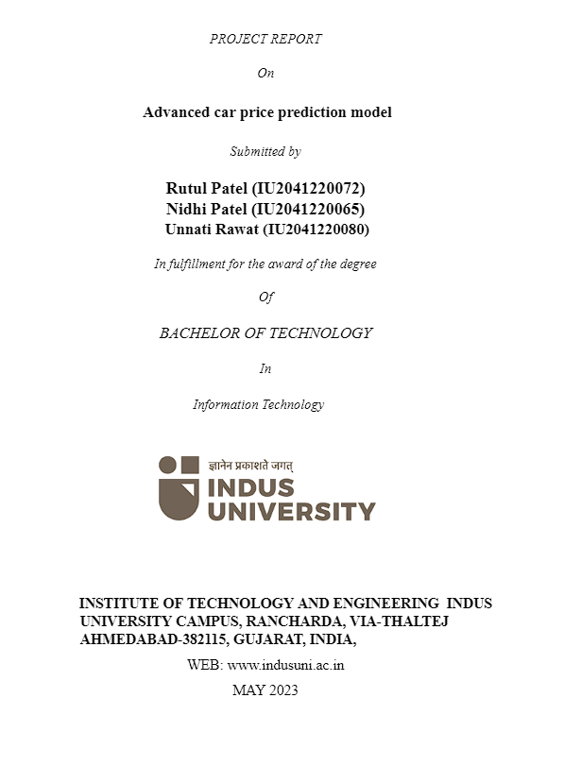

Slide 3
Table of contents
01 - Introduction
02 - Background Study
03 - Objective of the project
04 - Methodology or workflow of the project (System Design)
05 - Technology used
06 - Implementation
07 - Conclusion and Future Directions

Slide 4
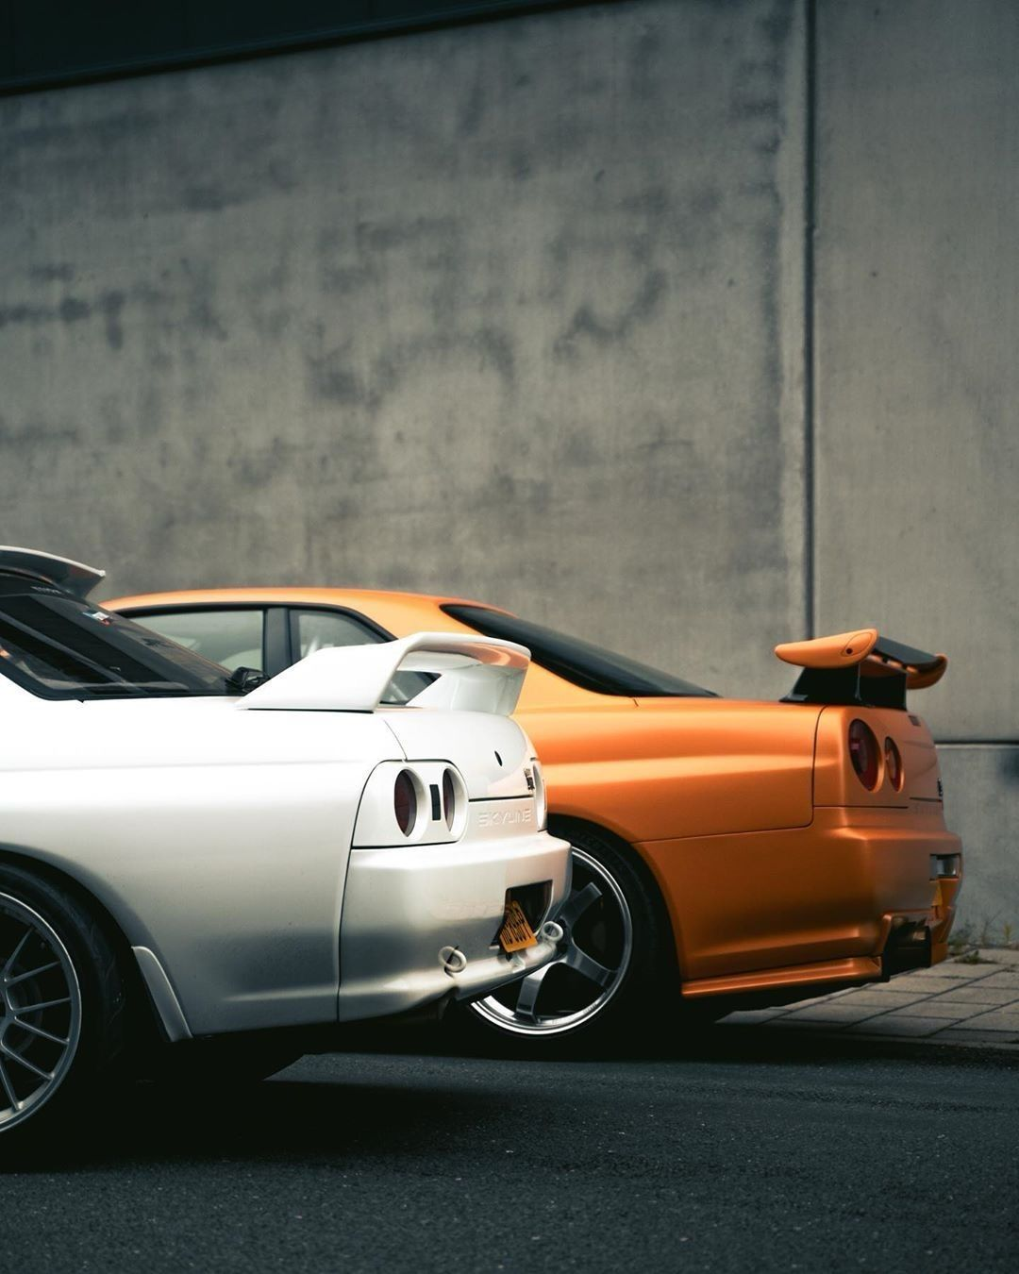
01
INTRODUCTION
Our project Advanced car price prediction model is designed to make selling a used car a smooth and transparent experience. We start with a user-friendly website where users can simply enter information about their used car. Our powerful machine learning model will then analyze this data and provide them with an initial estimated price for their vehicle.
Additionally we also offer an optional damage detection system. Users can upload images of their car, and our object detection model will identify and assess any damage it finds and this analysis will be factored into the final price. Our ultimate goal is to transform the used car market by bringing transparency, fairness, and efficiency to the entire process, benefiting both buyers and sellers.

Slide 5
02
Background Study
The background study for a used car valuation system with damage detection dives deep into the complexities of the used car market. This research examines factors that significantly affect a car's value, such as the make, model, year, mileage, and overall condition. It also explores the challenges faced by both buyers and sellers in this market. For buyers, a major concern is uncertainty surrounding the true value of a used car, potentially leading to overpaying or missing out on good deals. Additionally, hidden damage can be a significant risk, impacting the car's functionality and resale value. Sellers, on the other hand, often struggle to obtain reliable valuations for their vehicles, making it difficult to set a competitive asking price.

Slide 6
03
OBJECTIVE OF THE PROJECT
Our main objectives is to creates a user-friendly system for used car valuation. By combining machine learning for car features with image-based damage detection, it provides an initial price estimate and adjusts it for any identified damages. Our system uses web interface which guides users through the process, making car valuation transparent and efficient.
It tackles the current challenges of uncertainty and potential bias in car pricing by the power of machine learning. Ultimately, this project seeks to enhance user satisfaction by offering a fair, transparent, and accurate used car valuation experience.

Slide 7
04
WORKFLOW (SYSTEM DESIGN)
ER Diagram
Data flow Diagram
Class diagram
State chart Diagram
Activity Diagram
Use case Diagram
Sequence diagram

Slide 8
05
Technology used
Frontend : HTML, CSS, Javascript and Jinja.
Backend : Python, Flask, OpenCV, Keras
Frameworks: Darknet, Tensorflow

Slide 9
06
IMPLEMENTATION
Data Acquisition and Preprocessing : Acquired a well-structured car dataset including various features. Manually collected additional images to address data diversity and specific requirements. Imputed missing values, encoded categorical features, scaled numerics, considered feature engineering, and augmented and resized images (for damage detection).
Model Selection and Training : Explored various algorithms to identify the best fit for our dataset and desired accuracy. Split data into training, validation, and testing sets.
Deep Learning : Convolutional Neural Networks (CNNs) are adept at image classification and object detection. Explored different models of YOLO like v3 and v4 for real-time detection.
Developed a user-friendly interface : We built a user interface to collect car data and upload images for damage assessment, integrating the price prediction model with damage detection for adjusted price predictions.

Slide 10
07
CONCLUSION & FUTURE DIRECTIONS
This system can be further enhanced. Newer YOLO models (v7/v8) would improve accuracy and speed. Larger, more diverse datasets would improve real-world applicability. User accounts could enable personalization, tracking valuations, and market trends. Data analytics could provide insights on damage-based price changes and regional variations.
We've built a user-friendly system for used car buyers and sellers. It combines car valuation with damage detection to deliver fairer market prices. The system has room for growth, with potential for managing data sets and analyzing user trends. This gives the way for an even more valuable tool in the future.

Slide 11
References
List of Literature Survey References:
  Jihad Qaddour, and Syeda Ayesha Siddiqa. “Automatic damaged vehicle estimator using enhanced deep learning algorithm.” 2023, https://www.sciencedirect.com/science/article/pii/S2667305323000170
  Mallios, Dimitrios & Xiaofei, Li & McLaughlin, Niall & Martinez-del-Rincon, Jesus & Galbraith, Clare & Garland, Rory. (2023). Vehicle Damage Severity Estimation for Insurance Operations Using In-The-Wild Mobile Images. IEEE Access. PP. 1-1. 10.1109/ACCESS.2023.3299223.
  Rakshata P, Padma H V, Pooja M, Yashaswini H V ,Karthik V. “Car Damage Detection and Analysis Using Deep Learning Algorithm For Automotive.” vol. Volume 5, no. issue 6, Nov-Dec-2019.
  Kyu, Phyu & Woraratpanya, Kuntpong. (2020). Car Damage Detection and Classification. 1-6. 10.1145/3406601.3406651.
  Rakshata P, Padma H V, Pooja M, Yashaswini H V ,Karthik V. “Car Damage Detection and Analysis Using Deep Learning Algorithm For Automotive.” vol. Volume 5, no. issue 6, Nov-Dec-2019.

Slide 12
List of Web References
  https://www.python.org/
  https://github.com/pjreddie/darknet
  https://www.tensorflow.org/guide/keras

Slide 13
Thank you

